Slide 1
Transfers (2)
Upgrades
Central Office >> IFSS >> Supervisor (sender) >> Bluetooth >> All Interviewers (receivers)

Slide 2


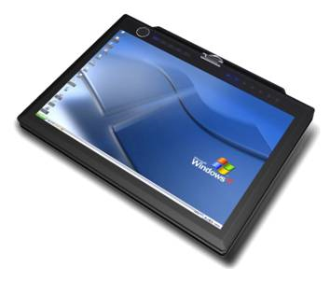
Upgrades – Overview
Need a quick, convenient way to update the DHS CAPI system while in the field or during training
Typical reasons for upgrades:
Fix bugs in data collection programs
Implement changes to the sample
Update team and supervisor databases
Upgrade system uses Internet to transfer upgrades to supervisor tablets in the field
Supervisor is then responsible for transferring upgrades to team members using Bluetooth transfer via menu system
Upgrades also used during training to fix bugs and other issues with questionnaires
Expect to receive at least one upgrade during fieldwork and several during training
Central Office System
Internet transfer
Supervisor’s System
Bluetooth transfer
Interviewer’s System

Slide 3




Steps to implement Upgrades
Supervisor receives upgrade automatically from Central Office via IFSS/SyncCloud/CSWeb
All interviewers prepare to receive upgrades
Supervisor sends upgrades
Team confirms upgrade and restarts menus

Slide 4
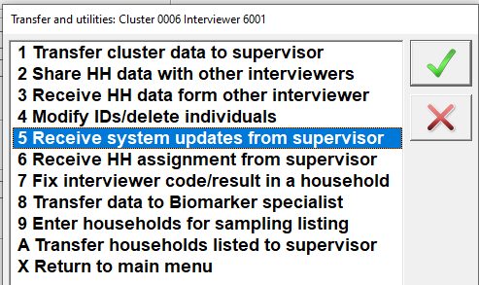
The Transfer Menu
Number | Title | Description
1 | Transfer cluster data to supervisor | Send all data collected by you in the cluster to the supervisor
2 | Share HH data with other interviewer | Share data for a household with another interviewer
3 | Receive HH data from other interviewer | Receive data for a household from another interviewer so you can carry out interviews for eligible individuals in that household
5 | Receive system updates from supervisor | Receive updates of the CC_DHS system from you supervisor
6 | Receive HH assignment from supervisor | Receive the data file containing household assignments to interviewers from supervisor

Slide 5

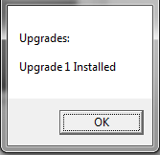
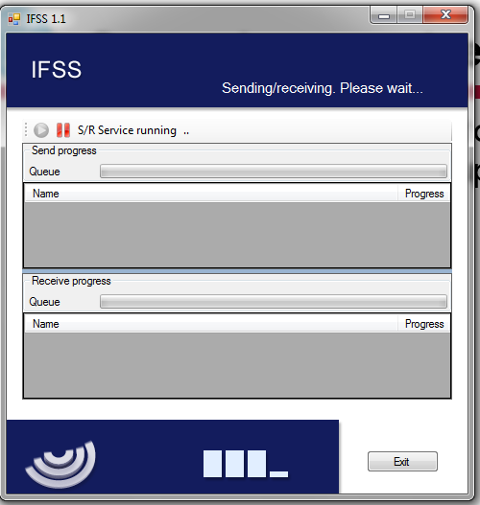

Supervisor receives upgrade
Connect to the Internet
Note: Each time supervisor logs into their menu,
the system checks for upgrades
Sends any data
Receives upgrades
Notes:
Connect to the internet, any upgrades will install (noted by box shown).

Slide 6
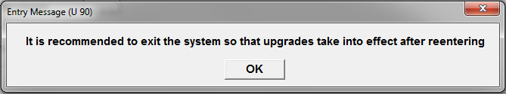
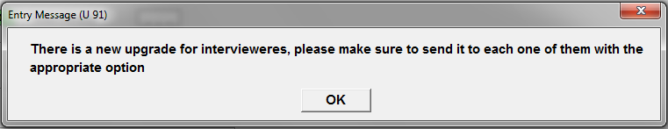
Supervisor receives upgrade
Before continuing work, close out system and alert interviewers there is an upgrade
Notes:
After watching whole power point, while showing each slide once at a time, tell interviewers to gather around to watch

Slide 7
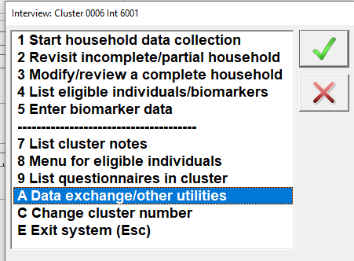
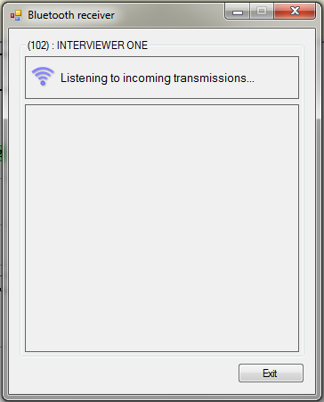
Interviewers prepare to get upgrades
Notes:
Tell supervisor interviewer is ready to receive upgrades

Slide 8
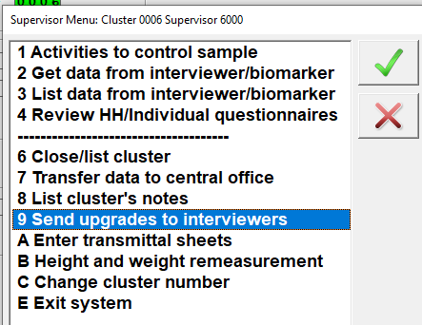
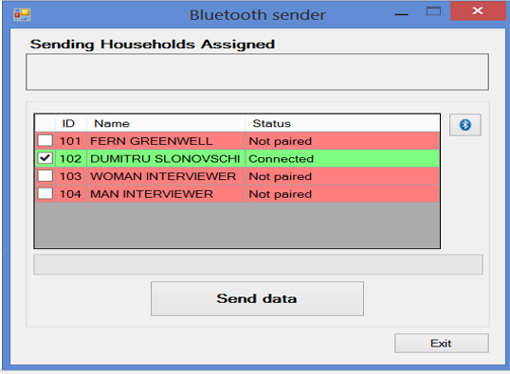
Supervisor sends upgrades to Team
Click Send data when ready
Notes:
Supervisor menu item A… when paired, send data ☺ Note that all interviewers can receive upgrades at once.

Slide 9

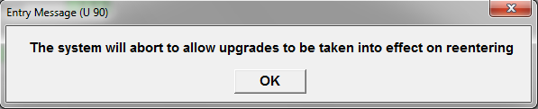
Interviewers Confirm upgrade received
Notes:
If interviewer sees these messages, it was a success. Note that if more than one upgrade is sent, they will download at the same time…

Slide 10

Key Points about upgrades
For supervisor, importance of connecting to Central Office each day to ensure that upgrades are downloaded in a timely manner
Upgrades are automatic for the supervisor
When a supervisor receives an upgrade they must send it to all team members without delay

Slide 11
Practice Time
Make sure
Supervisor’s ‘IFSS’ icon on desktop
One simple click on this icon will allow you to do automatic transfer and then start supervisor’s menu system
Enter IFSS user’s name and password for supervisors
Internet access
……
After all of the preparation

